Slide 1


Data Tagging & Deduplication Queries
29 Jan 2026

Slide 2

JobTech – Company Description Extraction
3
4
Tagging of each sentence with LLM, with human in the loop
Finetuning of BERT model with labelled data to categorize each sentence into categories
1
2
5
Cleaning of job descriptions
(html tags, PII)
Chunking of job descriptions into list of sentences
Each sentences chunk is categorized into 1 of the 6 categories
Sentence classifier

Slide 3

JobTech – SSIC classifer
1
2
3
With extracted company descriptions, classify each job into SSIC categories using multiple LLM
LLM as judge to score relevance and specificity of each classification, with human in the loop
Fine tune BERT based model with high scoring classification / Human selected classification
Jobs data with categorized descriptions
5
Each jobs is classified into a SSIC category
SSIC Classifier

Slide 4
Job deduplication workflow
4
Set deduped id to the matching job
1
2
3
Yes
Clean job descriptions and apply mini hash
Compare mini hash with jobs inserted past 60 days
Check if similarities
> 90%?
No
4
Insert the mini hash and job id into mini hash database

Slide 5
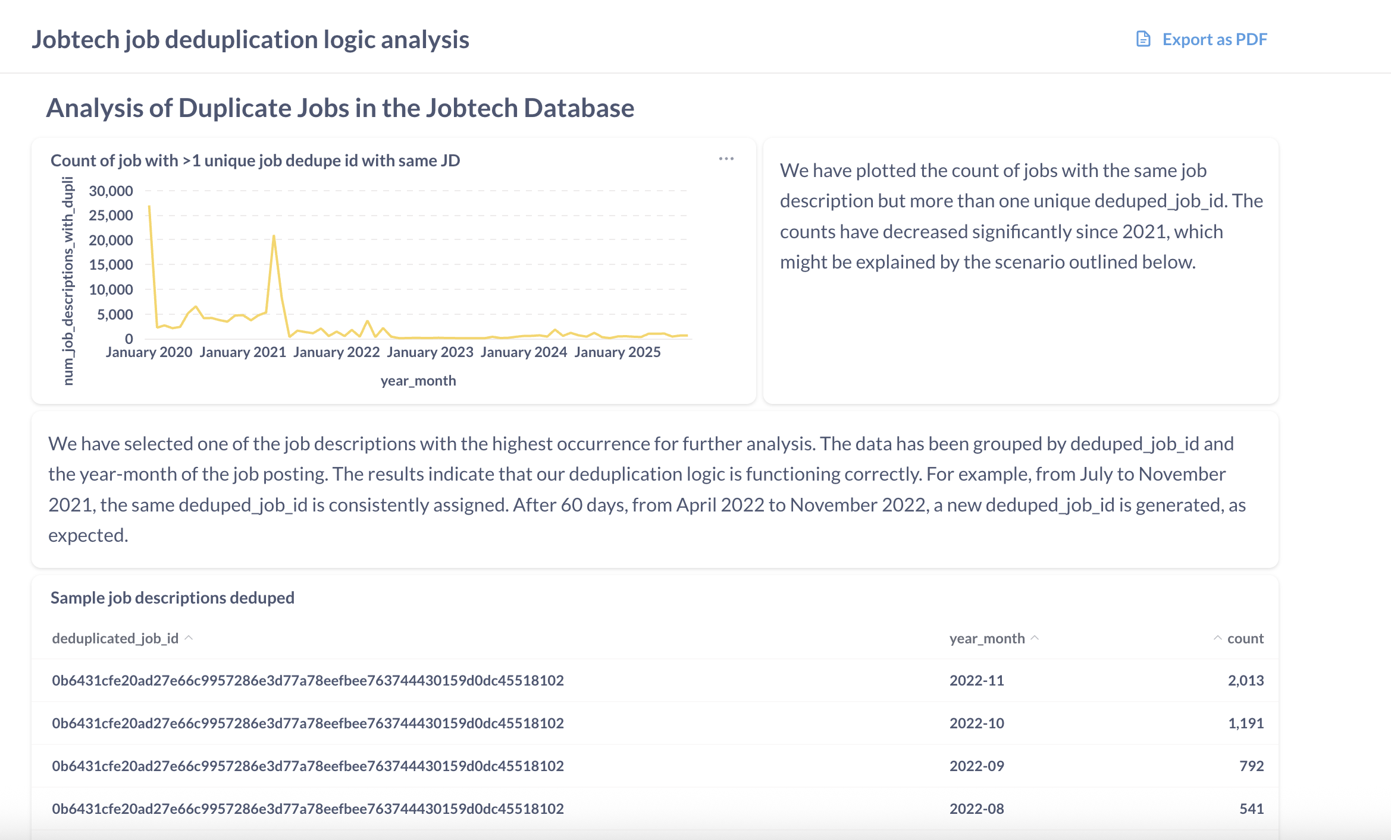
Job deduplication algorithm analysis
Link to dashboard:
https://analytics.betalented.ai/public/dashboard/10ff3837-491c-41da-9c10-334e5d7c05a8

